Slide 1
Web CEO Assessment Training Module
Cancellation and search Engine Ranking
by Kat Orense (Oct 06, 2011)

Slide 2
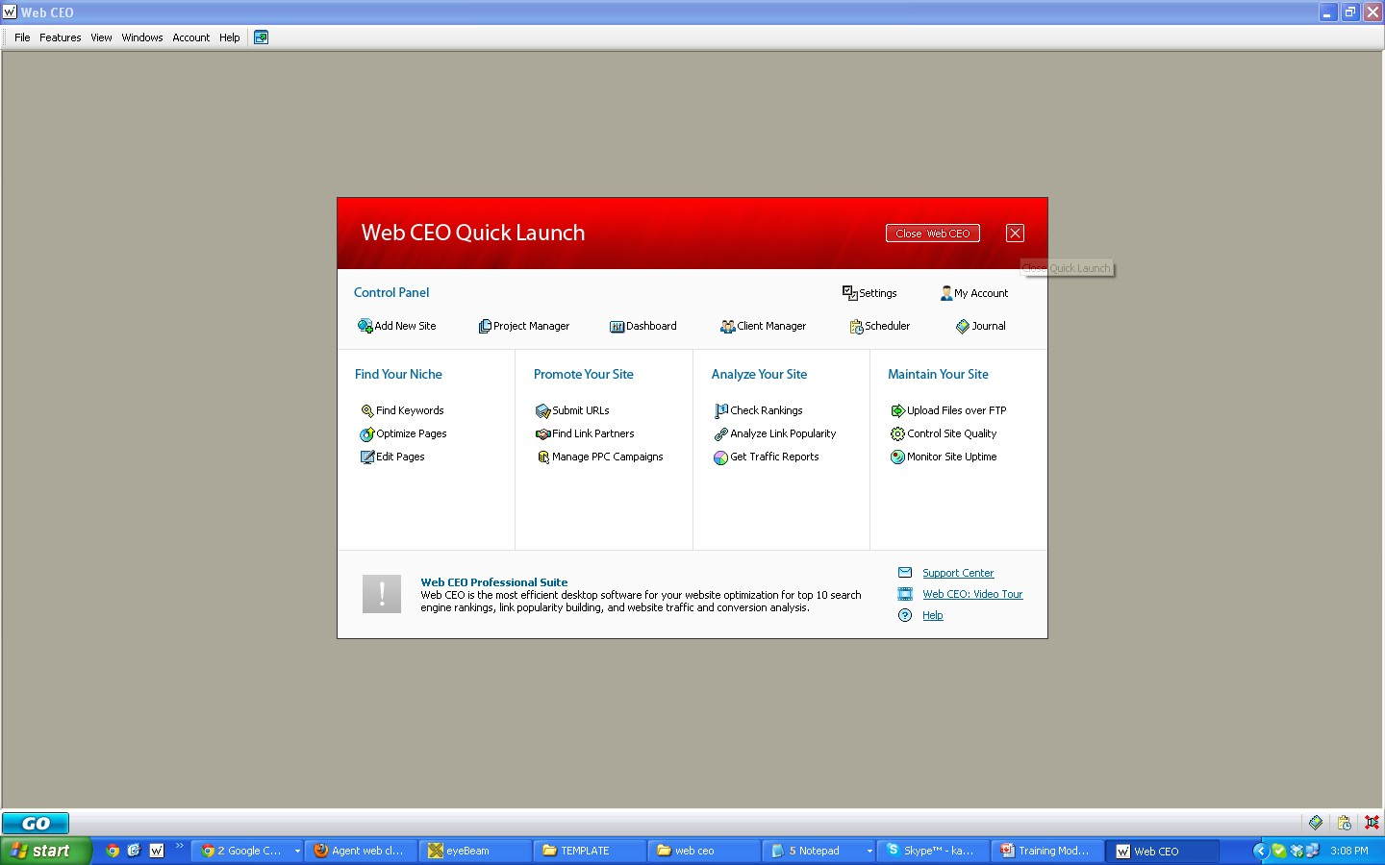
Click the “x” button

Slide 3
Click “ Features Button” and Go to “Ranking”

Slide 4
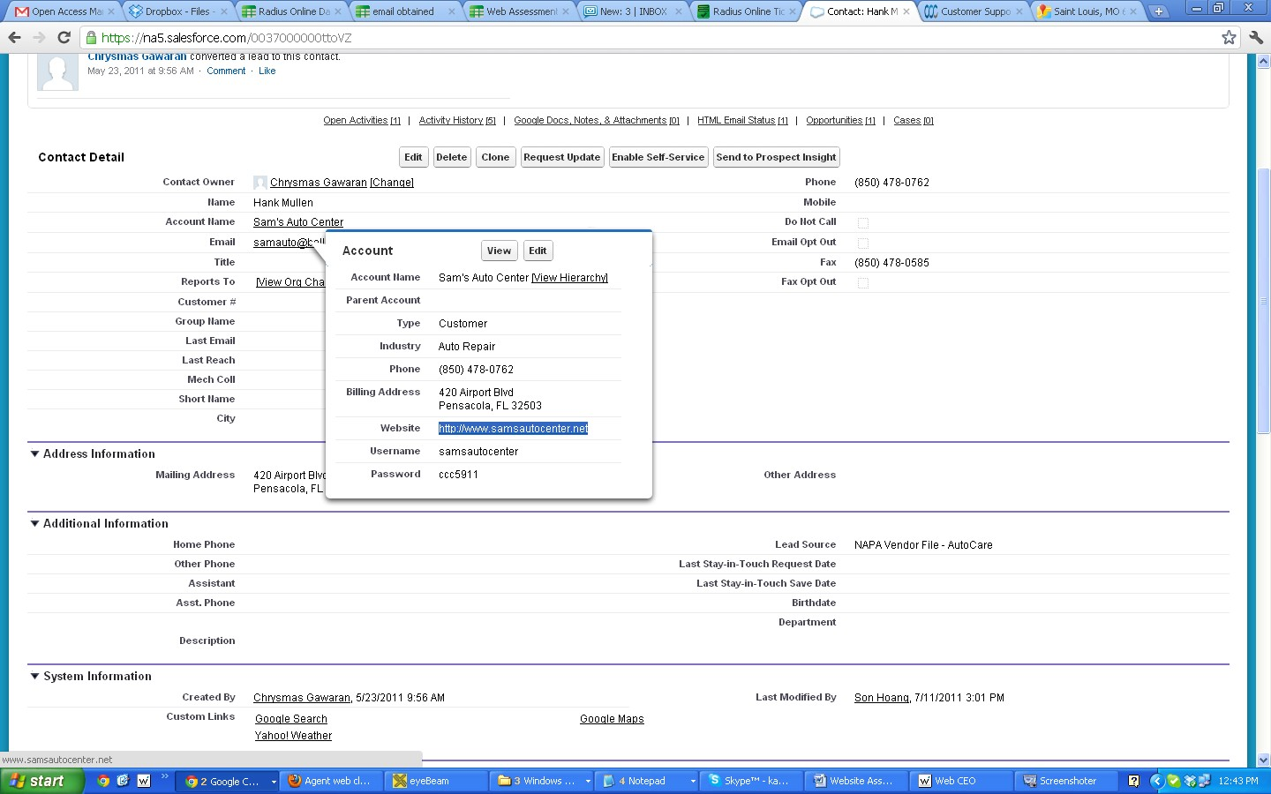
Go to “Salesforce” and Copy the Website

Slide 5
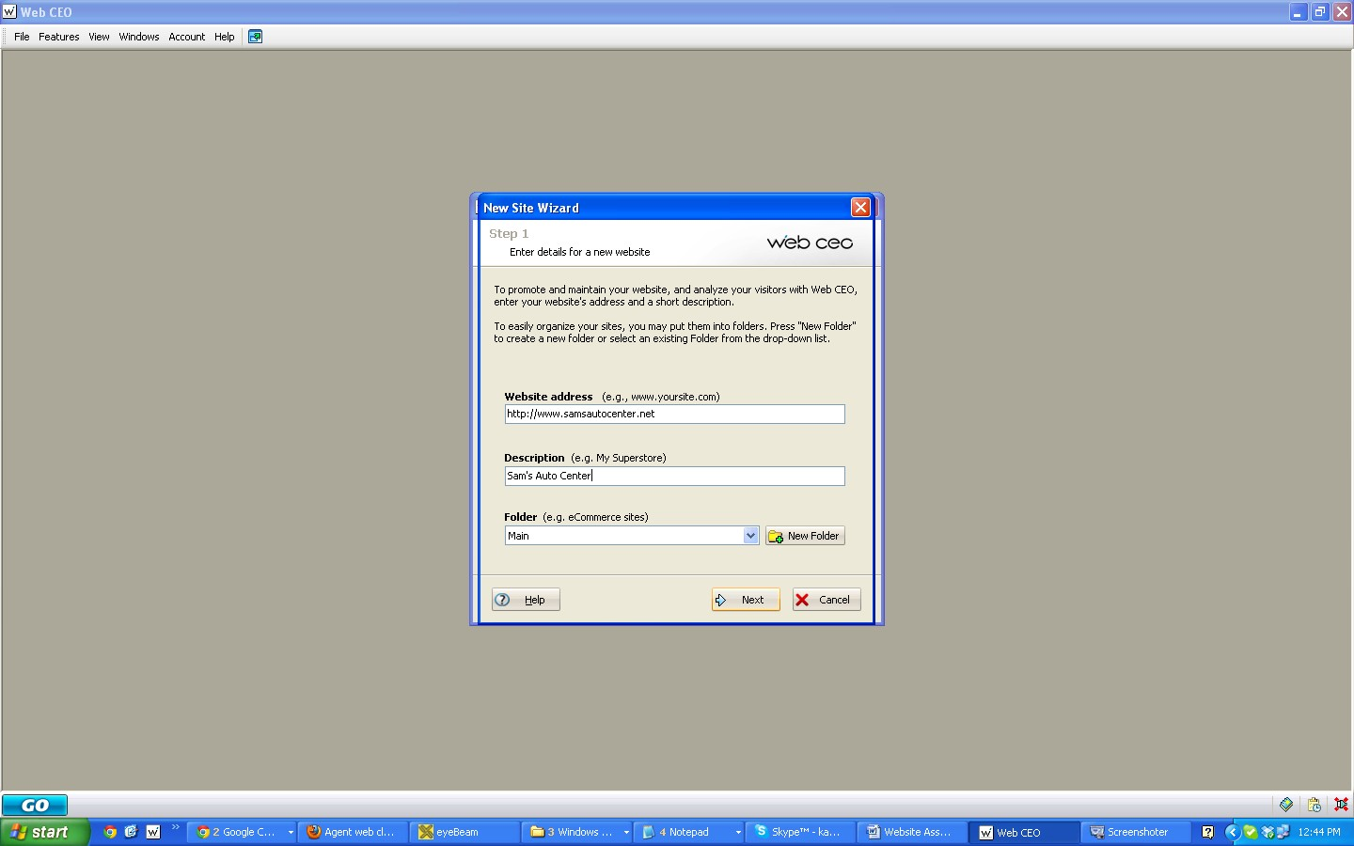
Go back to Web CEO and type in the Web Address.
Enter the shop’s name in the description and click “Next”

Slide 6
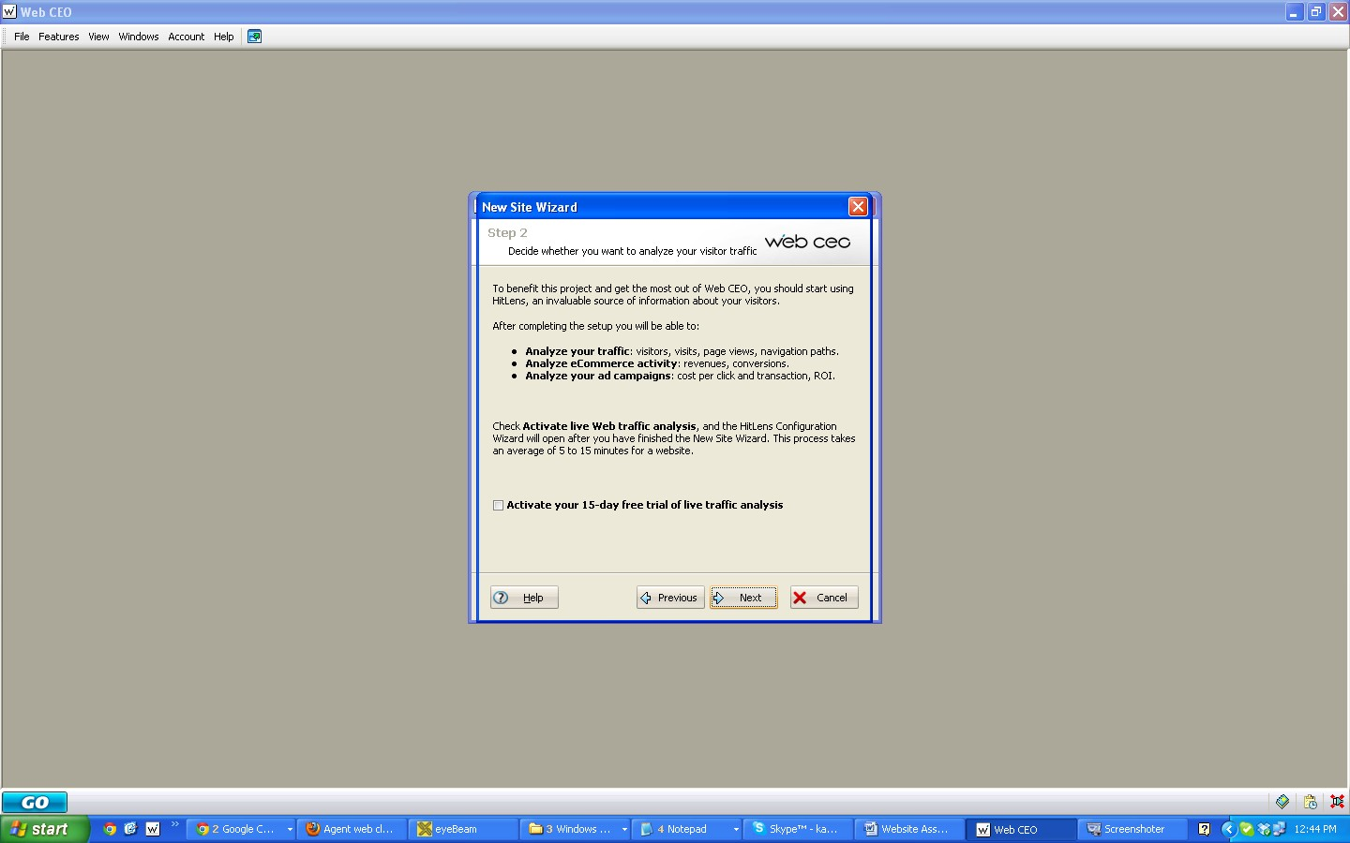
Click “next” button

Slide 7
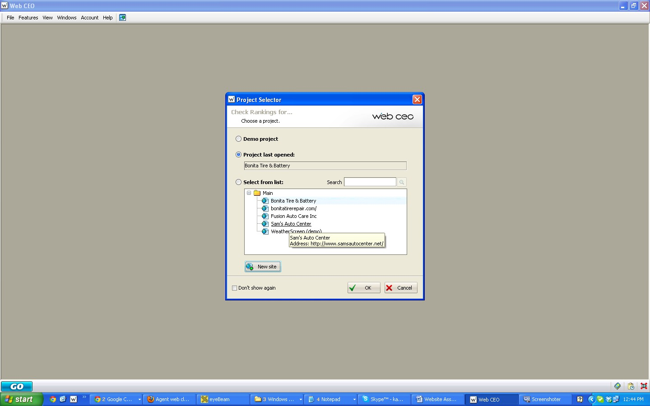
Click the website you created then “okay”

Slide 8
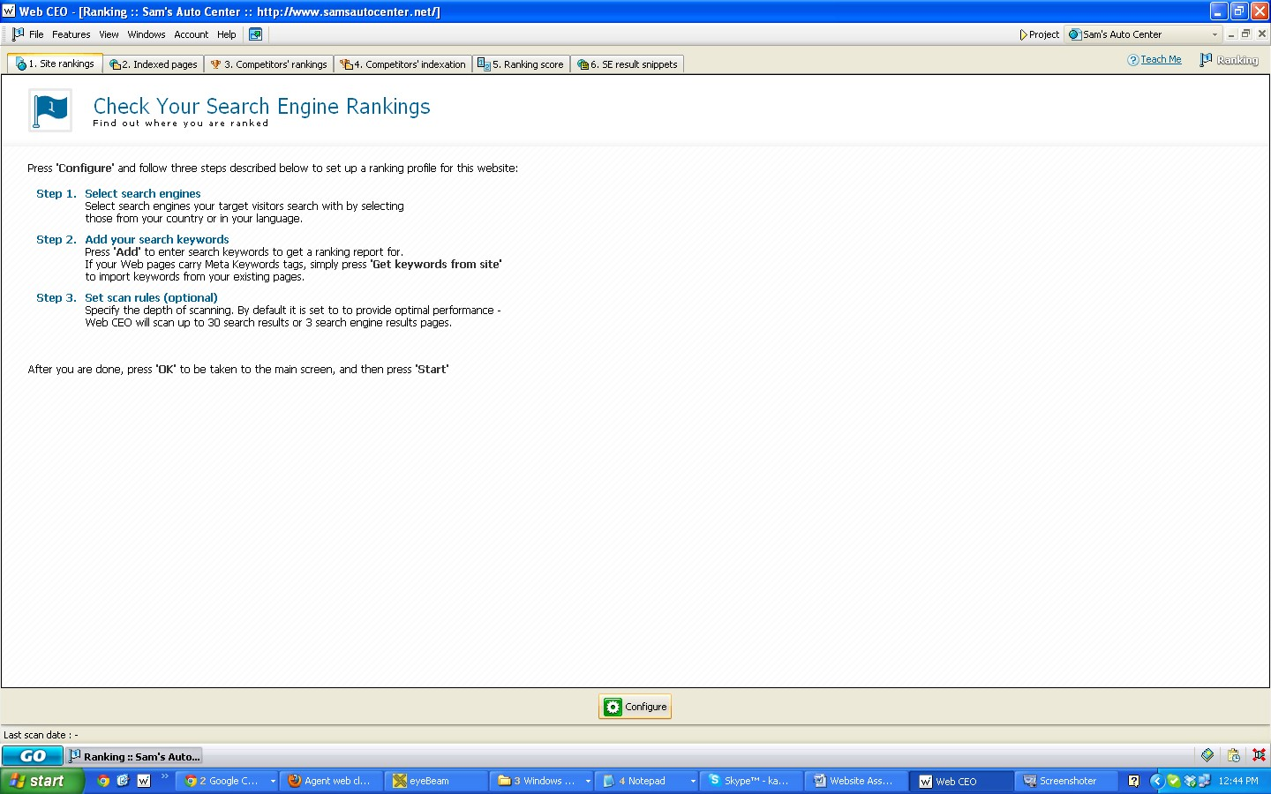
Click “ Configure”

Slide 9
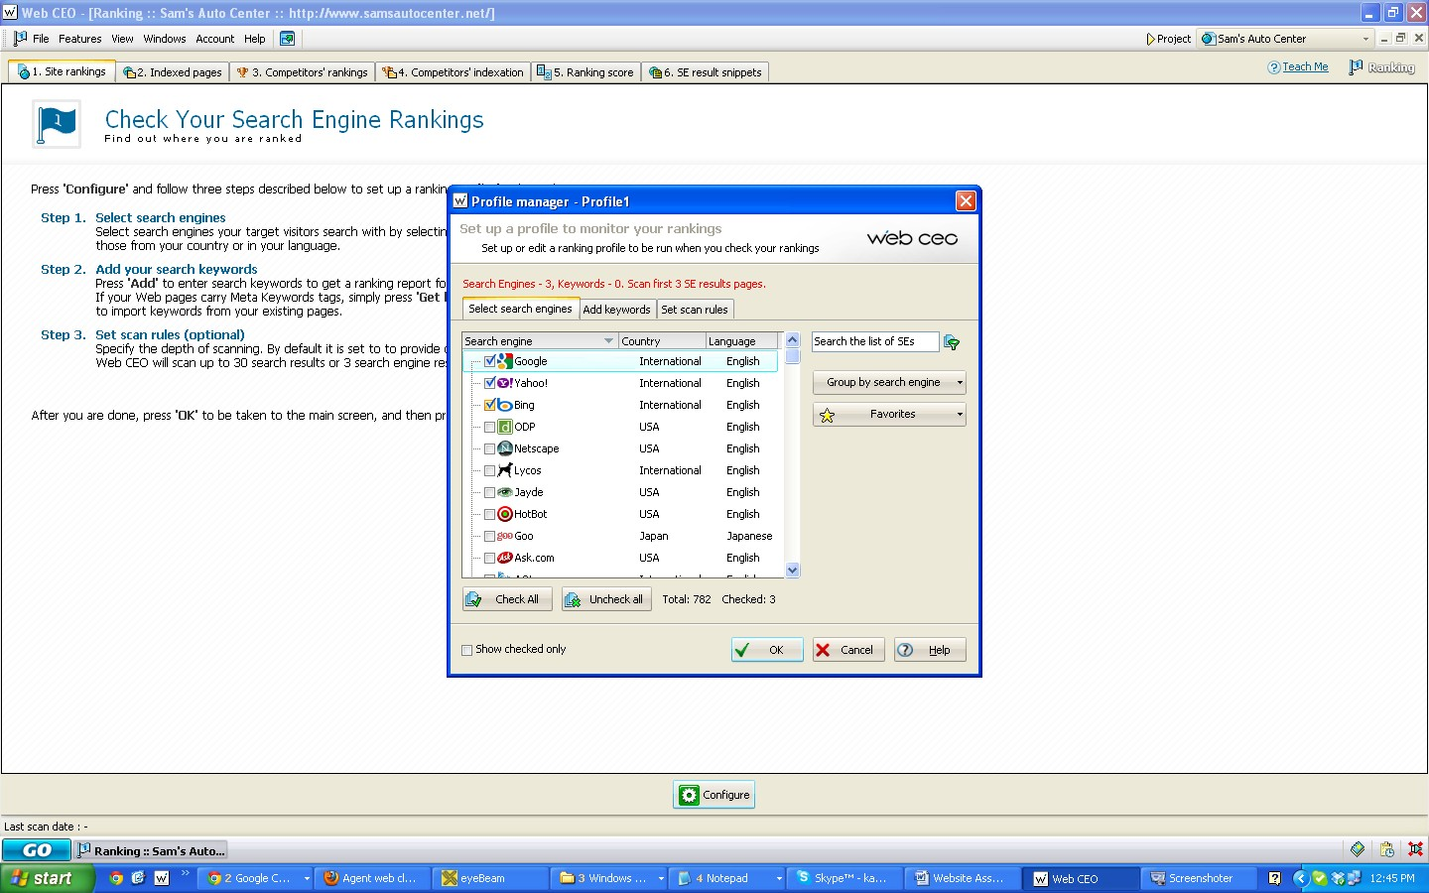
Check the boxes next to Google, Yahoo and Bing. Click the top 3 boxes.

Slide 10
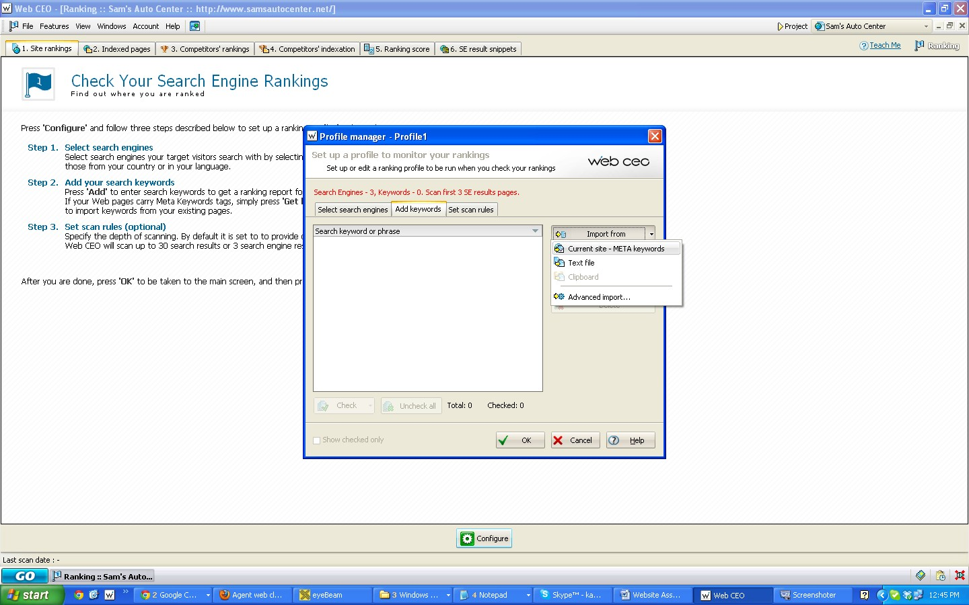
Go to Add keywords, click “import from” and “Current site” and click “Okay”

Slide 11
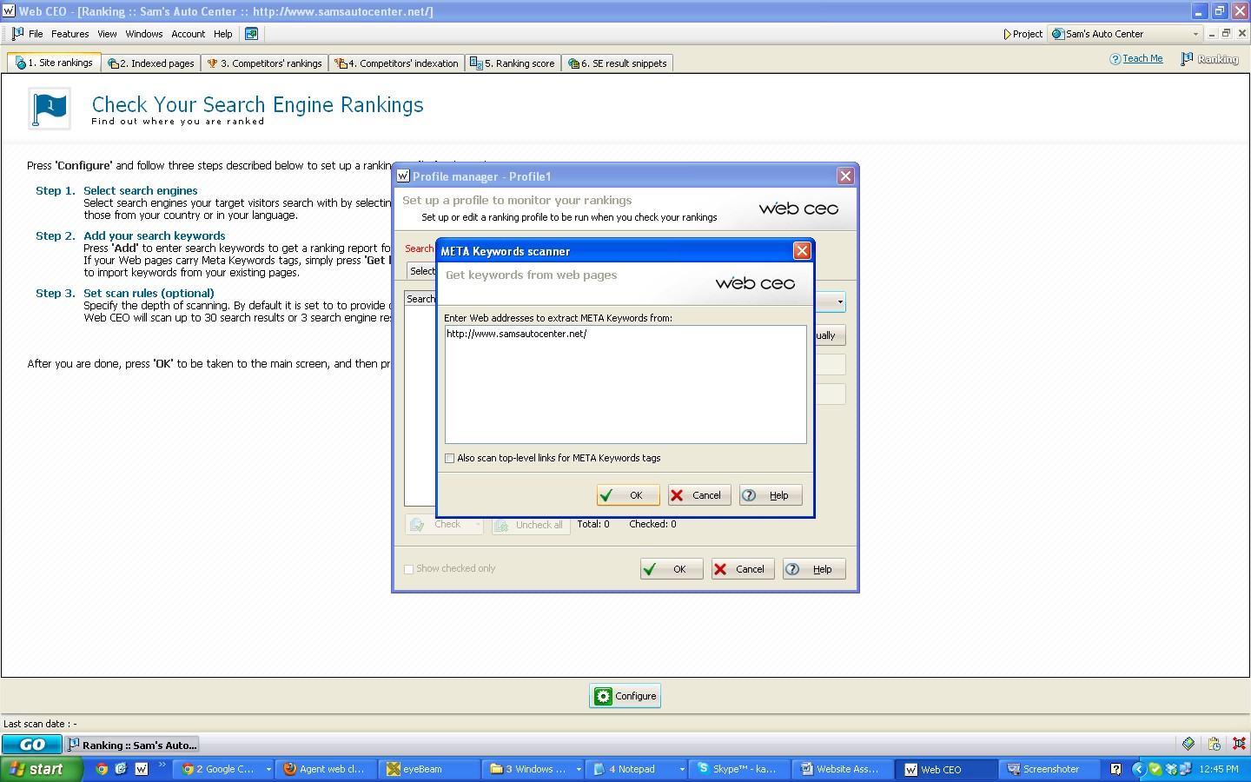
Click “Okay”

Slide 12
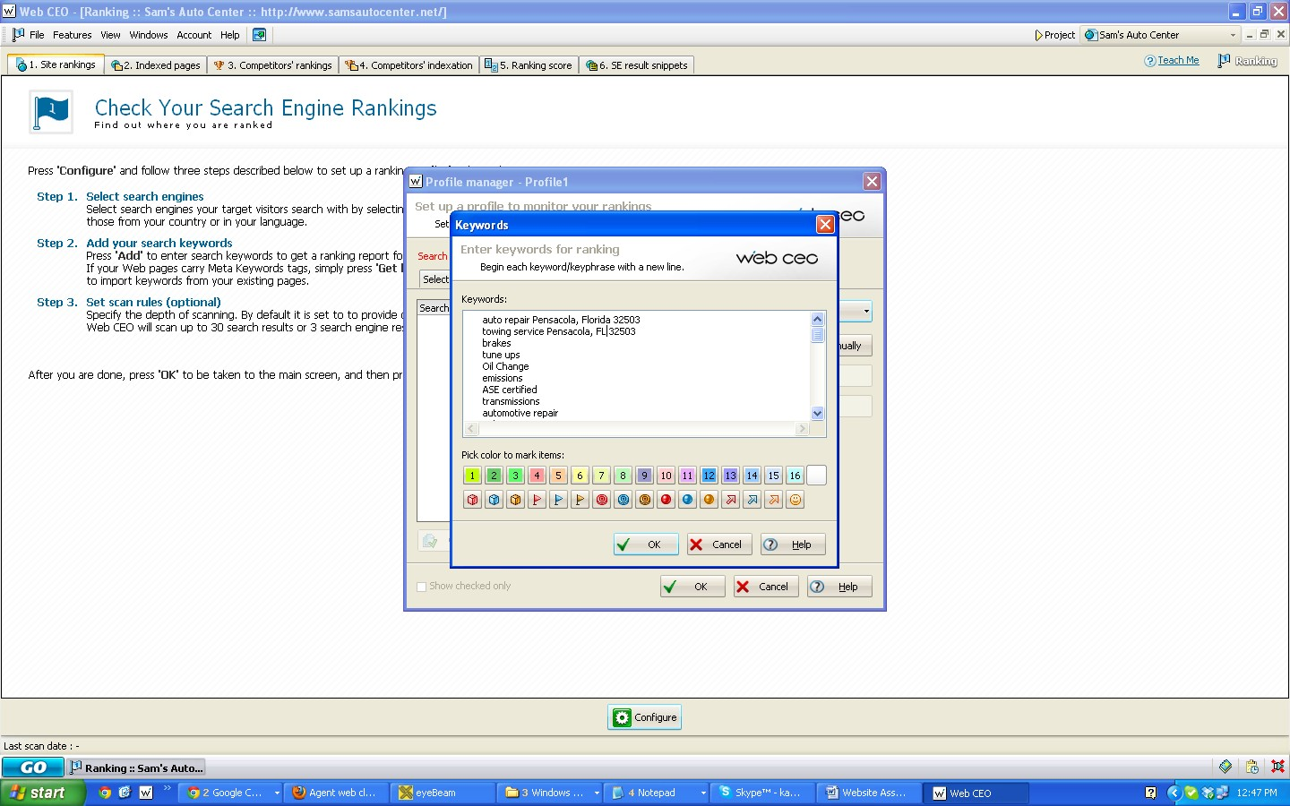
In the text area please use these keywords listed below and make sure you change the city and state to the customer’s city and state.
-Do not abbreviate the State for the first keyword, alternate each keyword by abbreviating the next line and the rest lines follows.

Slide 13
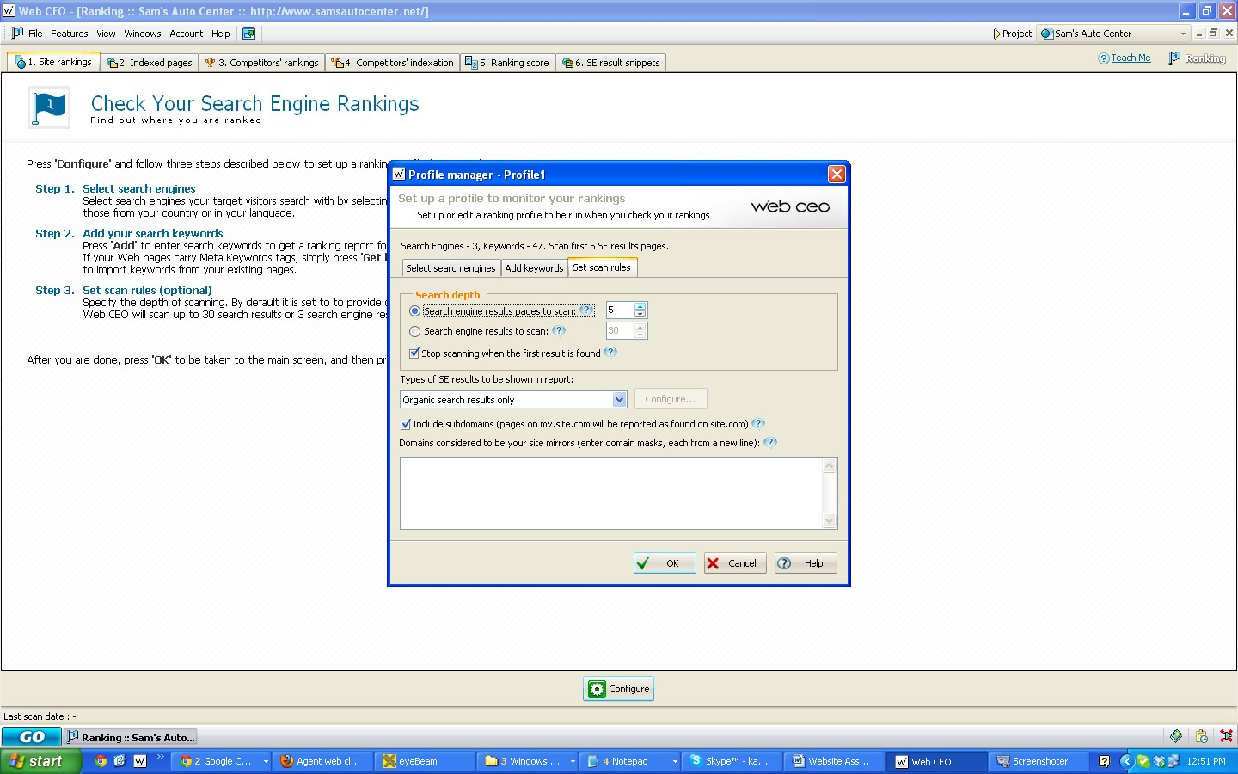
Go to Set scan rules Tab, and change the
“Search Engine result pages to scan to “5”
Then Click “Ok”

Slide 14
The configure button should now say Start. Press Start and wait for the results to finish. This may take a few hours to finish

Slide 15
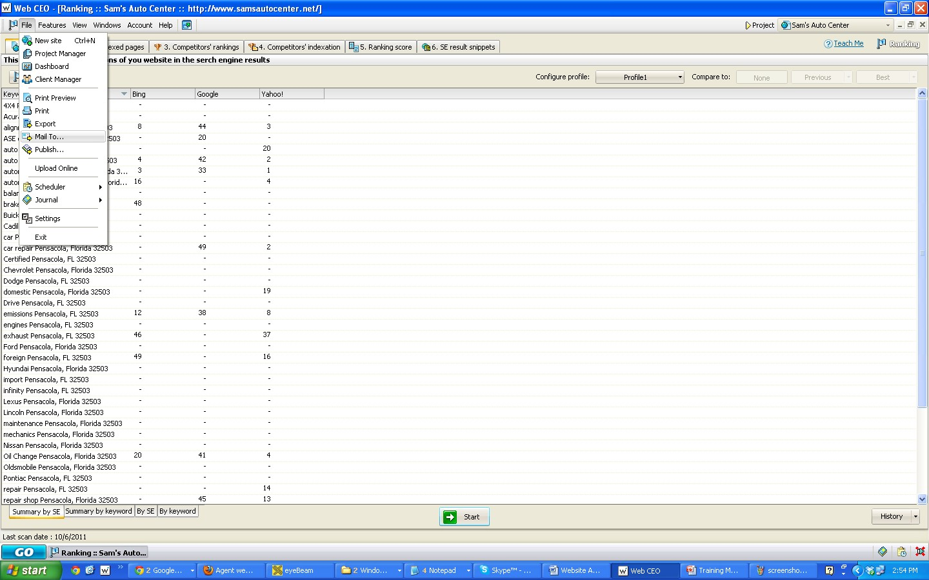
Once Completed, Go to “file” then “Settings”

Slide 16
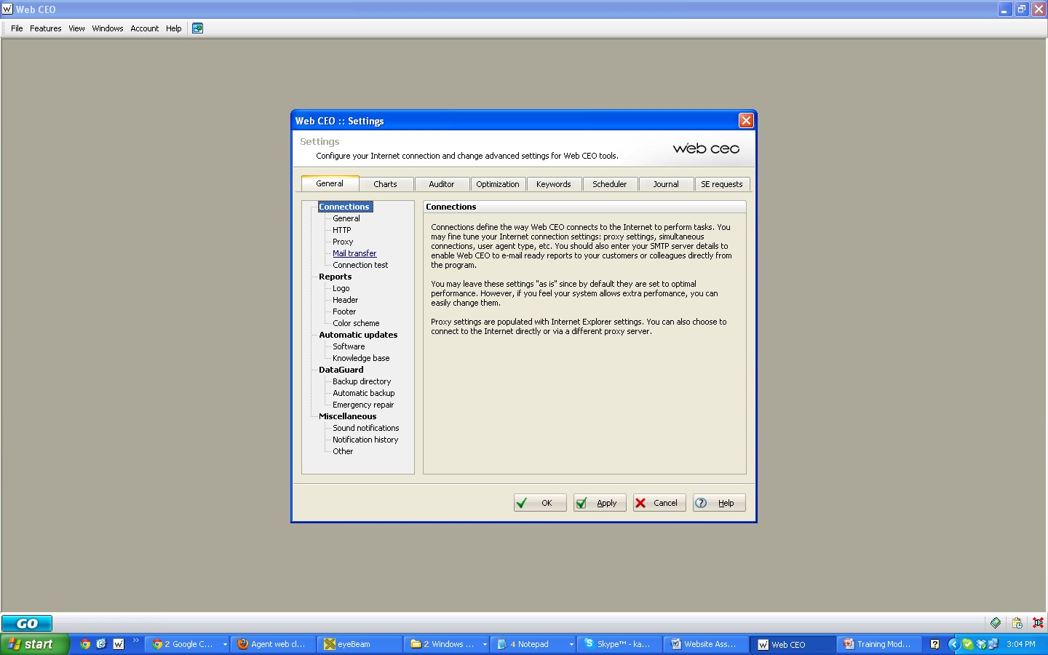
Click “Mail Transfer” and “Okay”

Slide 17
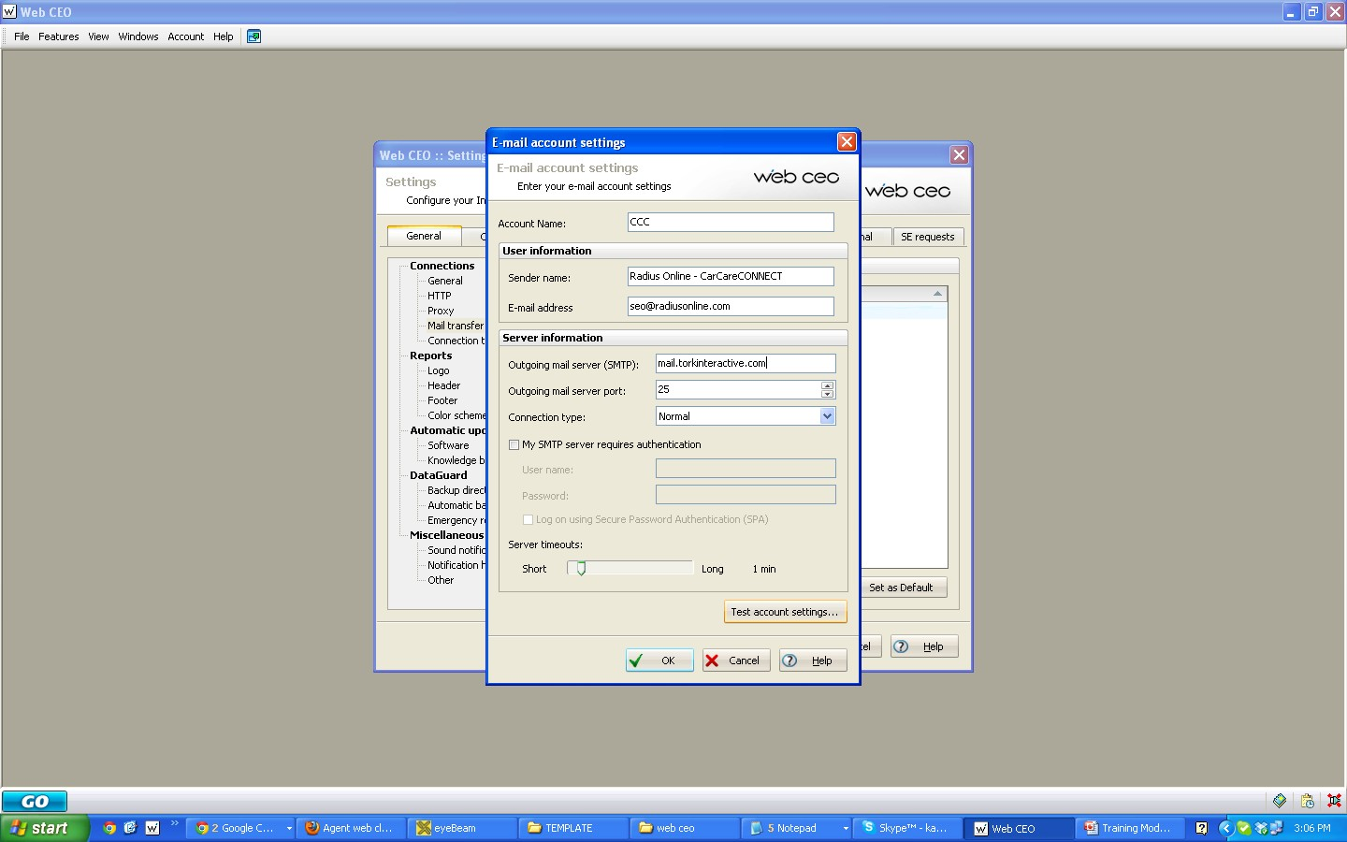
fill in with the following:
Account Name: CCC
Sender Name: Radius Online - CarCareCONNECT
E-mail address: seo@radiusonline.com
SMTP: mail.torkinteractive.com
Server port: 25
Connection type: normal
And click on “ Test Account Settings”

Slide 18
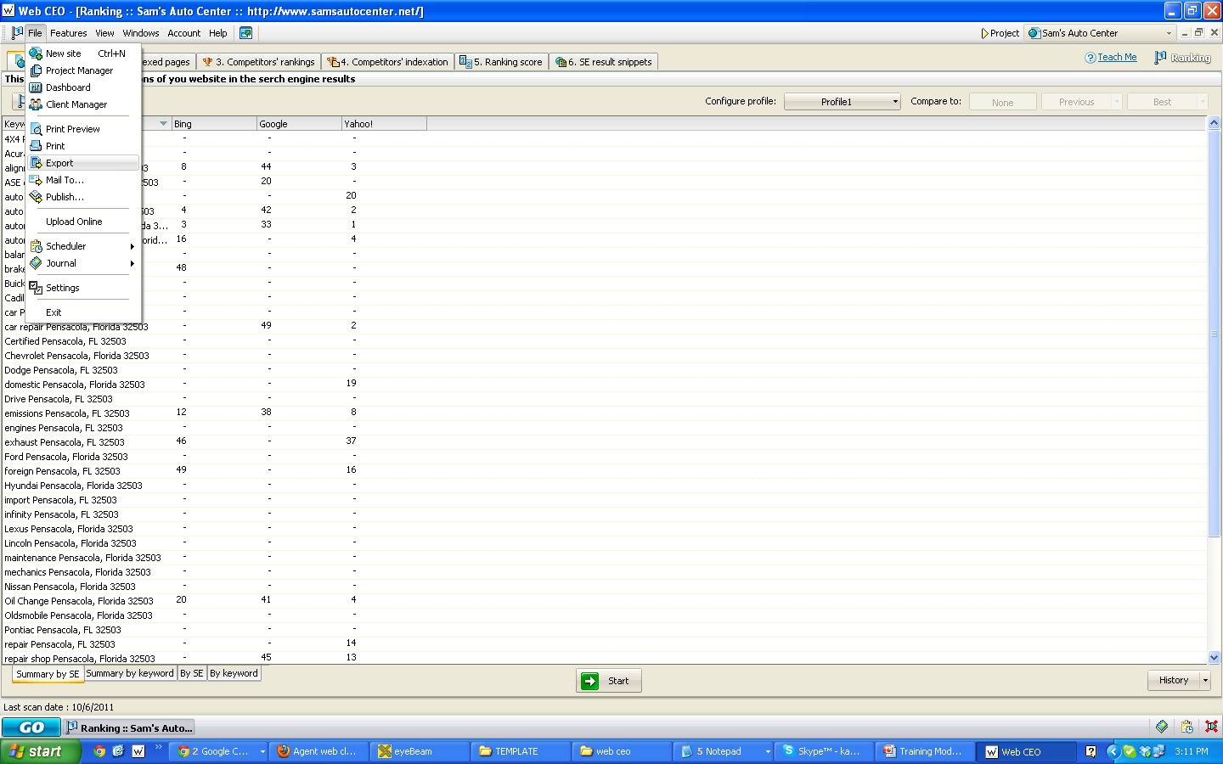
If an error occurs
Click on “ Export” and “Save”
You can save the file onto your desktop and then attach the document to an email.

